Slide 1
Feature Analysis and Price prediction for handsets
Presented By-
Himanshu Sharma

Slide 2
Introduction
Project Overview: Build a predictive model for handset pricing and analyze key features influencing prices.
Scenario: Supporting a leading handset sales organization in refining pricing strategies amidst market competition.
Key Outcomes: Accurate price prediction using machine learning models.
Actionable insights into influential handset features.

Slide 3
Dataset Details :-
Contents: Specifications of handsets such as memory, RAM, battery capacity, camera, processor, and price.
Primary Goals :-Develop a robust predictive pricing model.
Identify features with the greatest impact on pricing.
Data Exploration:- understanding data structure and feature distributions.
:- Correlation and outlier analysis.
Data Preprocessing:- Handling missing values and scaling data.
:- Encoding categorical variables.

Slide 4
Feature Analysis:-
Identifying key features using RFE, PCA, and other techniques.
Model Building:-
Experimenting with algorithms like Random Forests, Gradient Boosting, etc.
Model Evaluation:-
Metrics: MAE, RMSE, R².
Feature Importance Analysis:-
Validating feature influence using tree-based models.

Slide 5
Problem Statement
Title:- Feature analysis and price prediction for handset - A Predictive Model and insights for Pricing Strategy optimization.
. Data Exploration:- steps performed (missing value handling,outlier detection.
- Summary statistics and visualizations of key features.
. Data preprocessing:- Techniques used for cleaning, encoding, and scaling data.

Slide 6
.Feature Analysis:- correlation analysis and key insights. - Feature selection techniques applied (RFE,PCA) .Model Building :- algorithms tested, liner Regression, Decision Trees etc. - Model selection process and hyper parameter tuning. Model Evaluation:- Evaluation metrices MAE,RMSE R2 score
.Feature importance:- importance rankings from tree-based models.
- Visualizations of top features influencing price.

Slide 7
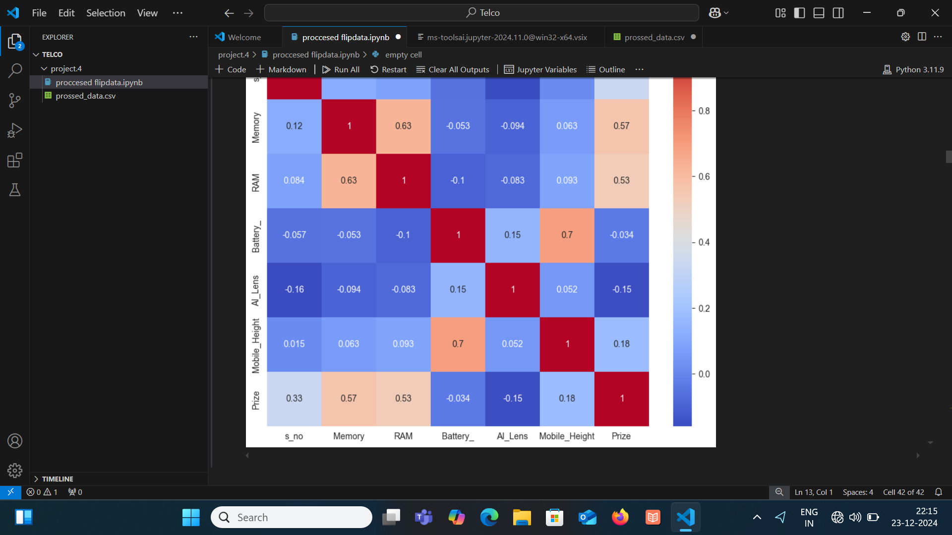
Feature analysis and price prediction for handsets correlation of heatmap

Slide 8
Model Selection
. In the first step for categorical encoding, we passed the index of columns to encode, and pass-through means pass the other numeric columns as it is. Use this code again by changing the algorithms and its parameters. We can also do feature scaling, liner regression, ridge regression lasso regression, Knn for preparing the this dataset.

Slide 9
Used libraries
Pandas
Numpy
Scikit -learn
Matplotlib
Seaborn
Jupyter Notebook
PowerPoint

Slide 10
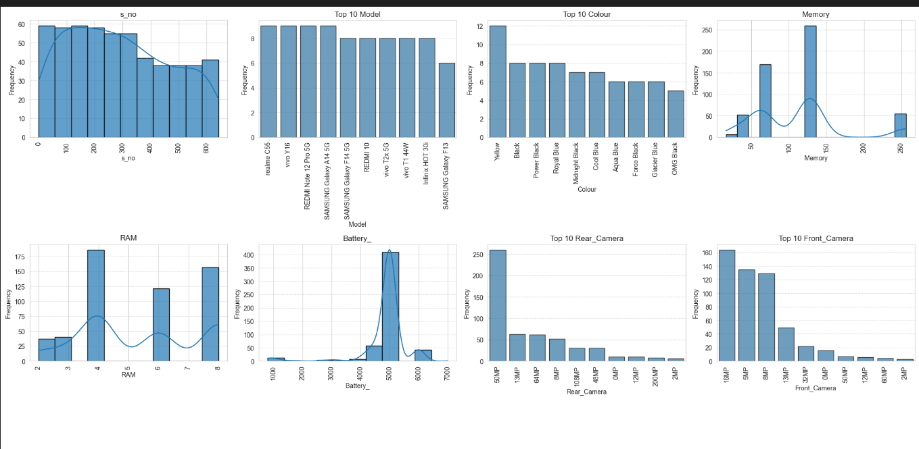
Model Evaluation

Slide 11
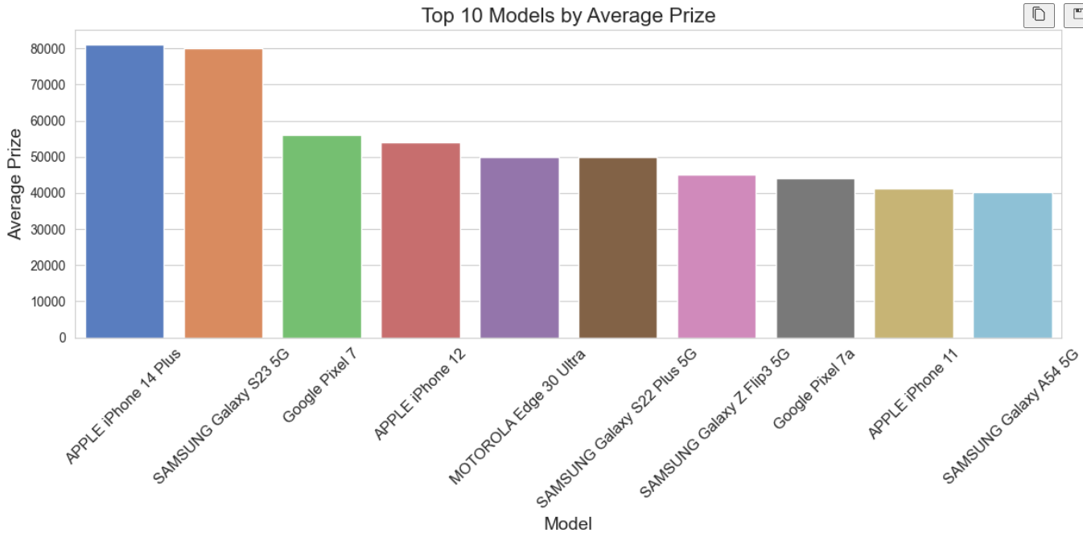

Slide 12
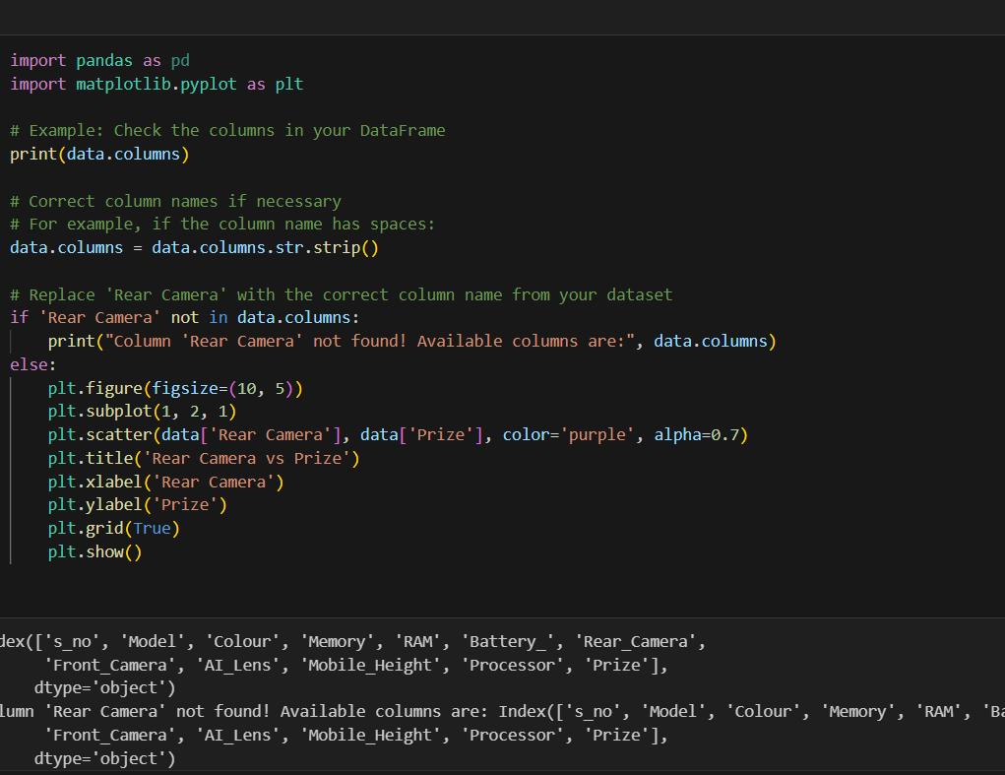

Slide 13
Conclusion
Feature Analysis:- Identified critical handset features influencing price, including memory, RAM, battery capacity, camera specifications, and processor type.
:-Performed correlation analysis and feature importance ranking to understand price determinants effectively.
Predictive Model:-Built and evaluated machine learning models for price prediction using techniques like Linear Regression, Random Forest, and Gradient Boosting.
:-Optimized model performance using hyper parameter tuning, achieving accurate price estimation metrics (e.g., R² and RMSE).
Feature Impact:- Verified feature importance through model analysis, aligning with initial exploratory findings.
:-Highlighted actionable insights into feature influence to refine pricing and marketing strategies.

Slide 14
Visualization and Reporting:-Created comprehensive graphs and visualizations showing feature distributions, price relationships, and prediction performance. :-Summarized findings and recommendations for business implementation. :-Leverage high-impact features (e.g., RAM, camera quality) in marketing and pricing strategies. :-Explore additional advanced modeling techniques for further performance improvement. :-Continuously monitor market trends to update models and ensure competitive pricing.

Slide 15
Thank You

